Slide 1
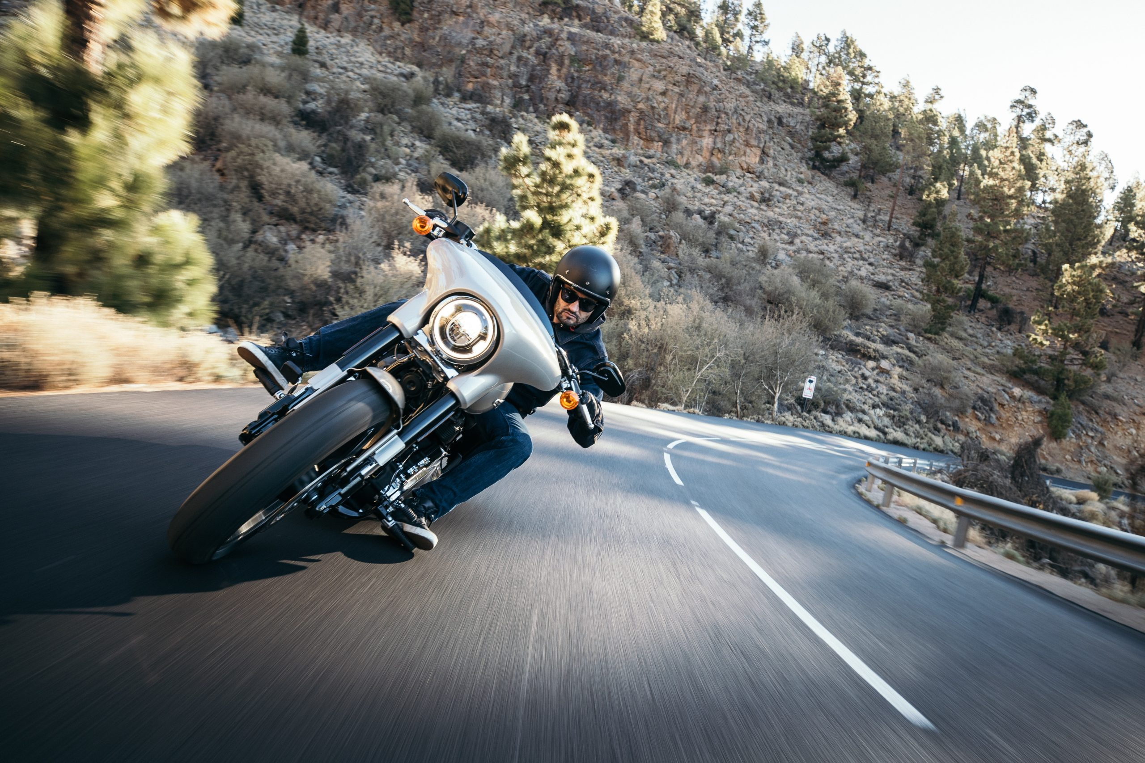

Modelling Motorbike Metrics
Institute of Data: Machine Learning and AI
Ciaran Mathewson

Slide 2
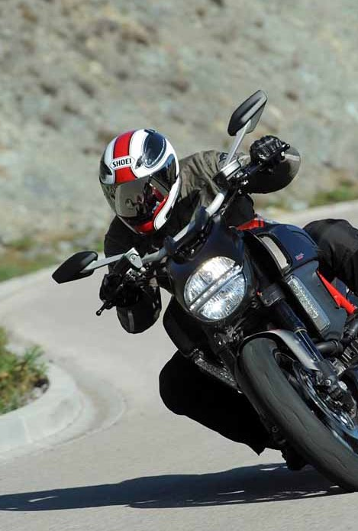
Background and Dataset
1
Business Question
2
3
Pipeline
4
Modelling
Feature Selection
5
Conclusions
6
Notes:
Here’s a rundown of what we’ll go through in the next 5 minutes

Slide 3


Background – benefits
Public benefits
Lower purchasing, rego, repairs, insurance costs (than cars)
Less for tolls and free parking
Efficient commuting (48% less time)
Rapid social interaction
Business benefits
Less damage to infrastructure, cheaper road upkeep
Easier traffic management
Lower insurance payouts
Environmentally ‘friendly’

Slide 4
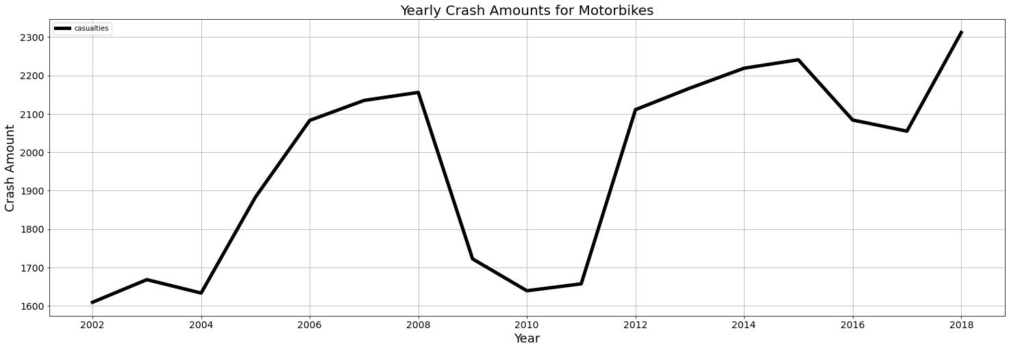
Background - issues
Open to the weather, less protection than cars, crashes trending upwards
Motorbike registration has doubled since 2005
Motorbikes are beneficial, so ensuring rider safety makes people more inclined to buy one

Slide 5
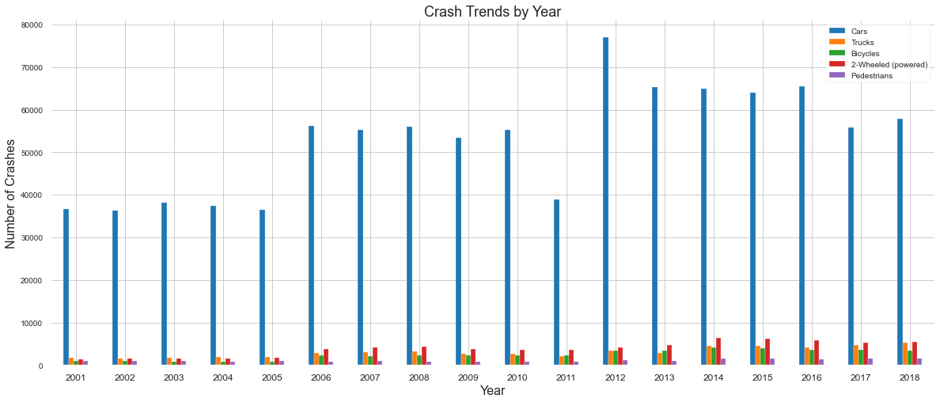
Dataset
Australia & New Zealand Road Crash Dataset, Kaggle
Over 1.1 million rows, in 6 individual tables
Joining tables and data cleaning, motorcycle-only crashes = 35,000 rows

Slide 6
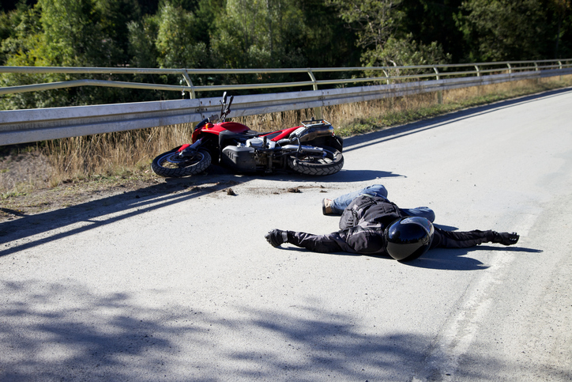
Business question
Can the most likely motorcycle crash scenarios be predicted?
This would target solutions, increasing confidence in riders and thus increase bike sales
Data Questions:
What are the most important features in motorbike crashes?
Has increased motorbike usage increased injury rate?
Stakeholders
Consumers, motorbike retailers, insurance and infrastructure companies, traffic and environmental analysts

Slide 7



pipeline
Business Question
Data Collection
Further Directions
Results Analysis
Data Cleaning
Modelling
EDA & Visuals

Slide 8
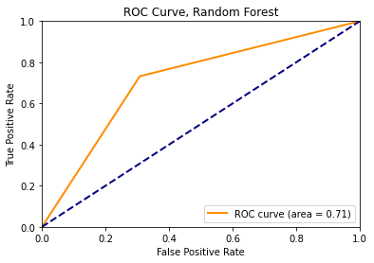
Modelling
Overall best model: Random Forest with tuned parameters
Recall (Type II, FN) most important and the highest metric
Still not ideal model, but better than random chance
A large amount of variables muddies the results
 | Precision | Recall | F1 Score
No Crash | 0.72 | 0.69 | 0.70
Crash | 0.71 | 0.73 | 0.72
Accuracy | 0.71 | 0.59 | 0.6
 | Precision | Recall | F1 Score
No Crash | 0.72 | 0.69 | 0.70
Crash | 0.71 | 0.73 | 0.72
Accuracy | 0.71 | 0.59 | 0.6

Slide 9

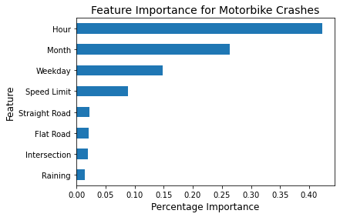




Feature selection - importance
Weather data, time and date, road conditions, lighting, intersections

Slide 10
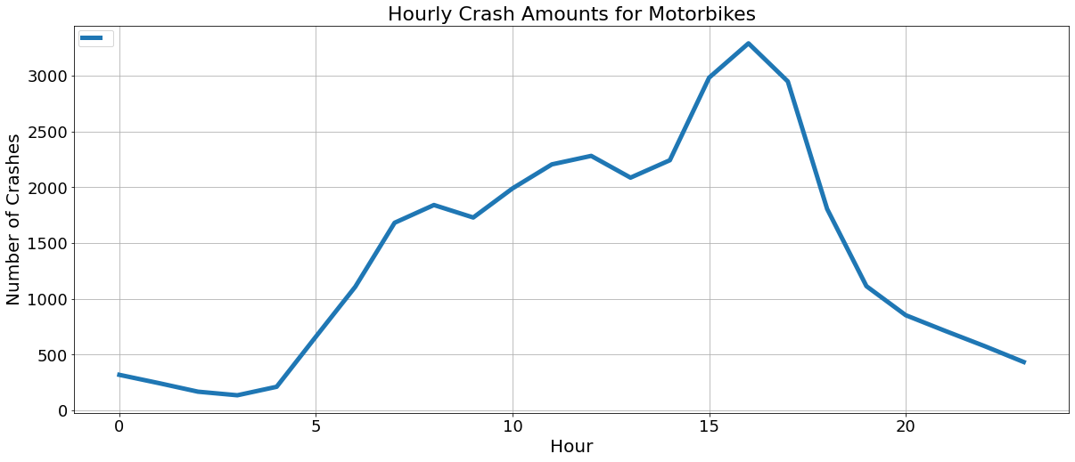
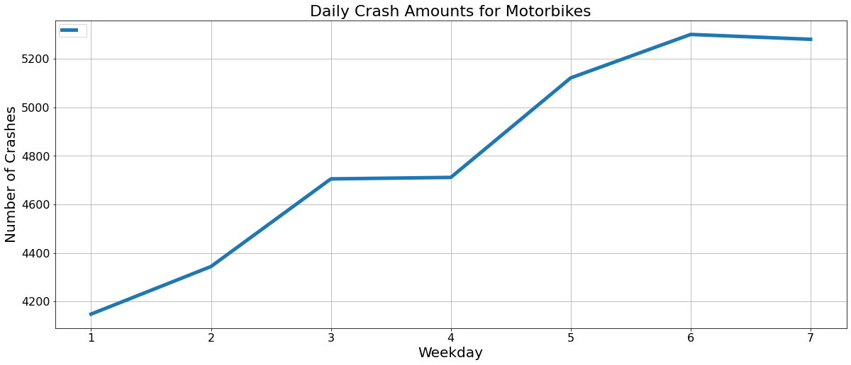
Feature selection - trends
Data Question 1:
What are the most important features in motorbike crashes?

Slide 11
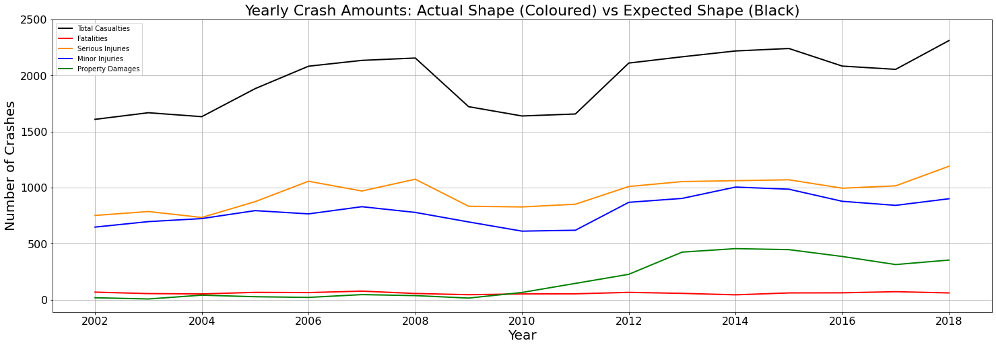
Feature selection - trends
Data Question 2:
Has increased motorbike usage increased injury rate?
Casualties have increased, but not by double (like motorbike registrations)
Majority are serious injuries and minor injuries, fatalities have stayed the same

Slide 12
Summary
Background and Questions
Motorbikes have many benefits, so promoting motorbike registration will improve personal life and finances for businesses
Can a model predict the primary causes of crashes to raise confidence in riders?
Has increasing riding uptake led to higher casualties?
Conclusions
A model can be created, however the amount of variables add noise
More features could have a factor, e.g. road surface material
Data analysis gives the best insights
Time and date are the biggest factors, followed by speed limit
Awareness campaigns around commuting times could be effective
Fatalities have not increased with increased motorbike registration

Slide 13
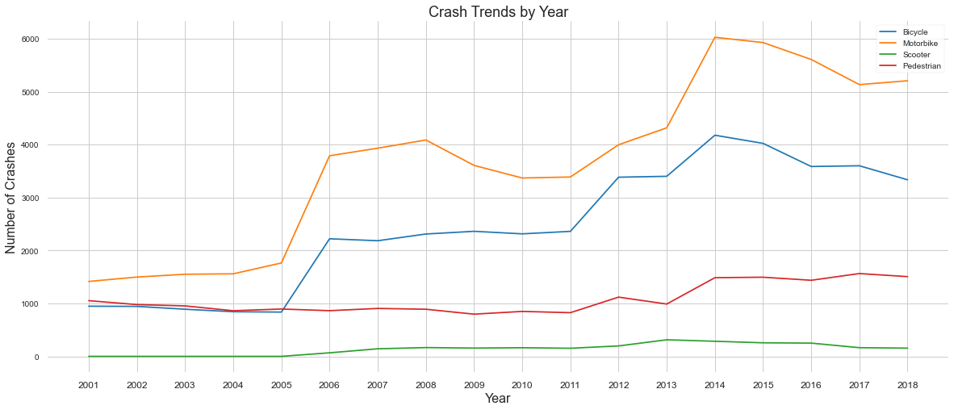
Further insights
Two spikes of increased casualties for bikes, motorbikes and scooters
Perhaps delivery companies? Menulog (2006), Deliveroo (2015), UberEats (2014-2016)
Interesting direction for future study

Slide 14
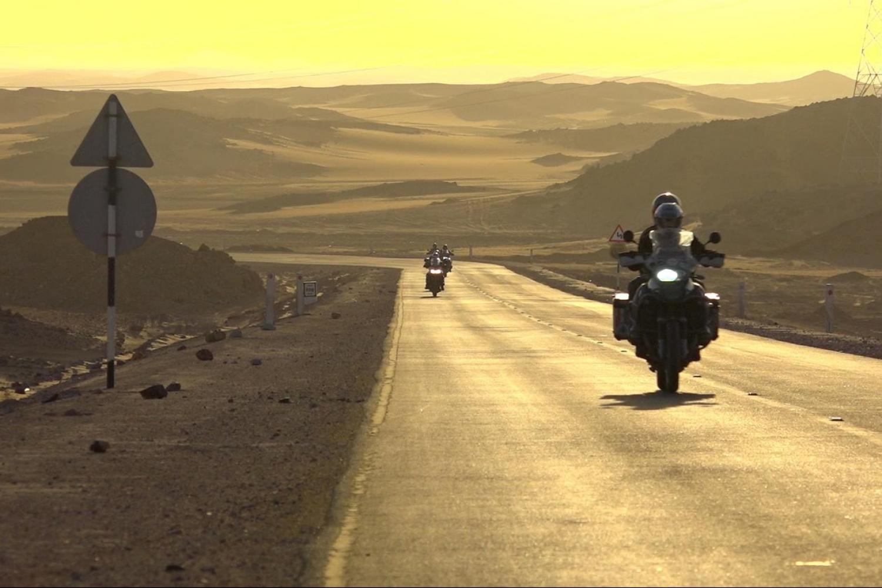
Questions?

